Slide 1
Caches: part 2
Kirill Korolev
15 February 2021

Slide 2
Agenda
Memory Wall
Spatial and temporal locality
Hardware implementations ←
Performance metrics
Software optimizations
Hardware optimizations (prefetching & replacement)
Write handling
Multi-level cache organization

Slide 3
Virtual memory partitioning
line number
offset
Address
0 | 0 | 0 | 0 | 1 | 1 | 1 | 0
14
3
2
byte address
0 | 1 | 2 | 3 | 4 | 5 | 6 | 7 | 8 | 9 | 10 | 11 | 12 | 13 | 14 | 15 | 16 | 17 | 18 | 19 | 20 | 21 | 22 | 23 | 24 | 25 | 26 | 27 | ...
0 |  |  |  | 1 |  |  |  | 2 |  |  |  | 3 |  |  |  | 4 |  |  |  | 5 |  |  |  | 6
main memory
line number

Slide 4
Fully associative cache
Direct mapped cache
Data
0x0A
tag =line number
Data
0xC3AF
offset
tag
set
offset
tag+set =line number
Address
1 | 1 | 1 | 0 | 1 | 1 | 1 | 0
Address
1 | 0 | 0 | 0 | 1 | 1 | 0 | 1
1 | 0 | 0 | 0 | 1 | 1 | 0 | 1
1 | 1 | 1 | 0 | 1 | 1 | 1 | 0
Tag
Array
Data
Array
Tag
Array
Data
Array
00 | C3 | AF | 00
00 | C3 | AF | 00
FF | FF | FF | FF
0 | 1 | 0 | 0 | 0 | 1 | 1
1
2
3
4
5
6
7
00 | 0A | 00 | 00
0
1
2
3
4
5
6
7
00 | 00 | 00 | 00
0 | 1 | 0 | 0 | 0 | 1 | 1
1 | 1 | 1 | 1 | 0 | 1 | 1
2
3
4
5
6
7
=
00 | 0A | 00 | 00
00 | C3 | AF | 00
FF | FF | FF | FF
0
1
2
3 | 1 | 1 | 1
4
5
6
7
00 | 00 | 00 | 00
0
1
2
3 | 1 | 0 | 0
4
5
6
7
0
1
2
3
4
5
6
7
=
=
=
=
=
=
=
=
hit/miss
data
hit/miss
data

Slide 5
Memory Layout: Direct Mapped Cache
64
0
Memory Space
Memory is virtually partitioned
into lines
line size = 2 ^ offset_size
lines grouped into slices
# of lines in slices = 2 ^ set_size
slice size = # of lines in slice * line_size = cache size
slice # = tag value
line # inside a slice = set value
Disadvantage is line evictions due to set conflicts
 | Offset
 | Set | Offset
Tag | Set | Offset
set#
cache size
set#
cache size
tag#
Mapped to the same set
set#
cache size
…
set#
cache size

Slide 6
2-Way Set Associative Cache
Conflicts are harmful → multi-ways cache is a solution
Each set holds two entries (way 0 and way 1)
Each line can be mapped into one of two entries in the appropriate set
Address
64 | 13 |  | 5 | 0
Tag | Set |  | Offset
way #0
way #1
Tag Array
Data Array
Tag Array
Data Array
set#
63
0
set#
63
0
0
1
…
255
0
1
…
255

Slide 7
2-Way Set Associative Cache
#lines = cache_size / line_size
#sets = #lines / #ways
offset_bits = log(line_size)
set_bits = log(#sets)
Address
64 | 13 |  | 5 | 0
Tag | Set |  | Offset
Tag Array
Data Array
#lines = 32KB / 64B = 512
#sets = 512 / 2 = 256
offset_bits = log(64) = 6
set_bits = log(256) = 8
way #0
way #1
way #0
way #1
set#
set#
63
0
63
0
0
1
…
255
0
1
…
255
=
=
MUX
hit/miss
data

Slide 8
Memory Layout: Multi-Way Cache
Memory Space
set#
way size
Memory is virtually partitioned almost the same as in direct map cache
The only difference is slice size
slice size = cache size / # of ways
Compared to direct map cache
Decrease slice size → increase # of slices → increase # of lines mapped to the same set
But in each set we can have multiple lines (= # of ways) at a given time
Example: 32KB, 8 ways, 64B line
way size = 32KB / 8 = 4KB
# of sets = 4KB / 64B = 64
Mapped to the same set
…
address
64 | 11 |  | 5 | 0
Tag | Set |  | Offset

Slide 9
Memory Layout: Multi-Way Cache
Slice is Nx smaller
For fully-associative cache N is equal to cache size in lines
For direct mapped cache N == 1
Address partitioning formulas:
set #
slice
Mapped to N cache lines
63 | Y |  | X | 0
Tag | Set |  | Offset
…
X = log(line_size)
Y = log(cache_size / N)

Slide 10
Performance metrics

Slide 11
Cache Performance
Terms:
Miss Rate = Misses / total CPU request
Hit Rate = Hits / total CPU request = 1 – Miss Rate
Cache goal is decreasing average memory access time (AMAT)
AMAT = Hit Rate * Hit Time + Miss Rate * Miss Penalty
AMAT ≈ Hit Time + Miss Rate * Miss Penalty
Example:
HitRate ≈ 0.9, HitTime ≈ 4 clk, MissRate ≈ 0.1, MissPenalty ≈ 200 clk, then…
AMAT = 0.9 * 4 + 0.1 * 200 = 23.6 clk
AMAT w/o cache = 200 clk
About 10x improve!

Slide 12
Motivation for multi-level caches
L1 cache: AMAT ≈ HitTimeL1 + MissRateL1 * MissPenaltyL1
L2 reduces L1 miss penalty – saves access to memory
Now, on L1 miss we access L2, but not memory
MissPenaltyL1 ≈ HitTimeL2 + MissRateL2 * MissPenaltyL2
L2 Cache is larger (better HitRate), but has higher latency
Example:

Slide 13
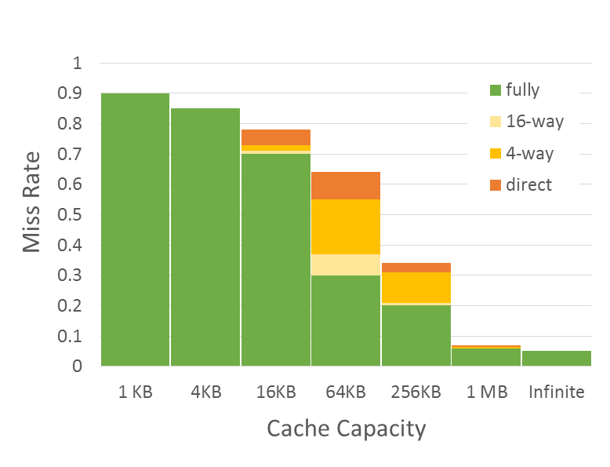
Three Types of Cache Misses (3-C)
Miss Rate = F(Cache Capacity, Associativity)
Conflict
Compulsory misses
Those that occurs even in a infinite cache
First access to data
So-called cold misses
Capacity misses
Those that occurs in an fully associative cache
Workset is larger than the cache size
Conflict misses
Difference between fully associate and direct mapped cache
The size of the cache is enough, but the problem is in line mapping to sets
Compulsory
Capacity

Slide 14
Software Optimizations

Slide 15
Loop Fusion
Combine loops that have same looping and work with the same memory
Assume each element is 8 bytes, 32KB cache, 64 B/line
for (i = 0; i < 10240; i++)
a[i] = 1 / a[i];
…
for (i = 0; i < 10240; i++)
sum = sum + a[i];
Fuse the loops
for (i = 0; i < 10240; i++) {
a[i] = 1 / a[i];
sum = sum + a[i];
}
Improves temporal locality

Slide 16
Loop Interchange
Change loops nesting to access data in order stored in memory
Two dimensional array in memory:
x[0][0] x[0][1] … x[0][99] x[1][0] x[1][1] …
Before:
for (j = 0; j < 100; j++)
for (i = 0; i < 5000; i++)
x[i][j] = 2 * x[i][j];
Improves spatial locality
Sequential accesses instead of striding through memory every 100 words
After:
for (j = 0; j < 100; j++)
for (i = 0; i < 5000; i++)
for (j = 0; j < 100; j++)
x[i][j] = 2 * x[i][j];
for (i = 0; i < 5000; i++)
x[i][j] = 2 * x[i][j];

Slide 17
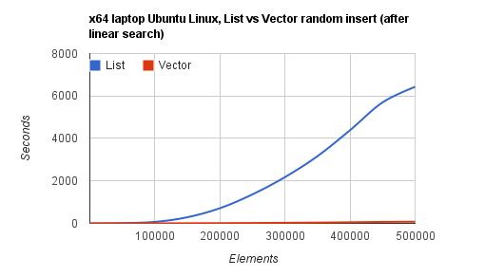
“Stop using linked lists”
Linked lists have no spatial locality
→ cache handles them worse than arrays
→ O(N) operation with array is much faster than O(N) operation with list
Example: random insert after linear search
https://kjellkod.wordpress.com/2012/02/25/why-you-should-never-ever-ever-use-linked-list-in-your-code-again

Slide 18
AoS vs SoA
Array of structures (AoS)
Structure of arrays (SoA)
struct map {
int val;
int key;
// ...
} merged_array[SIZE];
Locality if value and key are used together
Worse utilization otherwise
struct map {
int val[SIZE];
int key[SIZE];
// ...
} merged_struct;
Locality if value and key are used independently
Possible inter-set conflicts between values

Slide 19
Data alignment
Example: cache line size is 64 bytes, we load 4 bytes by address 0x3c
How many cache lines has to be looked up?
What if the first is hit and the second is miss?
Preferable solution: align memory access in a cache line
Required by many ISA, e.g. MIPS, RISC-V, x86 vector extensions
Basic sizeof(long double) alignment guaranteed by C
Alternative solution: add HW to make two accesses
Handles legacy cases and has worse performance (Amhdal’s law)

